Slide 1
R LIST
B . Jyothi
Assistant Professor
Department of Computer Science & Engineering,
Anurag University

Slide 2
LIST
In R, Lists are the objects of R which contain elements of different types such as number, vectors, string and another list inside it.
It can also contain a function or a matrix as its elements.
A list is a data structure which has components of mixed data types.
A list is a generic vector which contains other objects.

Slide 3
Creating Lists
list() function:
Syntax:
list(element_1, ...)
arguments:
-element_1: store any type of R object
...: pass as many objects as specifying.
each object needs to be separated by a comma

Slide 4
Creating a List
EX:
vec <- c(1,2,3)
char_vec <- c("Hadoop", "Spark", "Flink", "Mahout")
logic_vec <- c(TRUE, FALSE, TRUE, FALSE)
out_list <- list(vec, char_vec, logic_vec)
out_list

Slide 5
Giving a name to list elements
R provides a very easy way for accessing elements, i.e., by giving the name to each element of a list.
Creating a list.
Assign a name to the list elements with the help of names() function.
Print the list data.

Slide 6
Giving a name to list elements
# Creating a list containing a vector, a matrix and a list.
list_data <- list(c("Shubham","Nishka","Gunjan"), matrix(c(40,80,60,70,90,80), nrow = 2),
list(“M.Tech",“MBA","B.Tech"))
# Giving names to the elements in the list.
names(list_data) <- c("Students", "Marks", "Course")
# Show the list.
print(list_data)

Slide 7
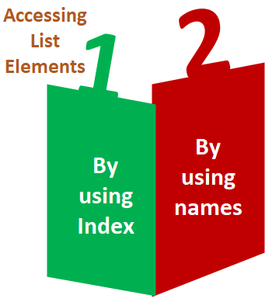
Accessing List Elements

Slide 8
Accessing List Elements
use the [[index]] to select an element in a list.
The value inside the double square bracket represents the position of the item in a list we want to extract.
For instance, we pass 2 inside the parenthesis, R returns the second element listed.

Slide 9
Manipulation of list elements
R allows us to add, delete, or update elements in the list. We can update an element of a list from anywhere, but elements can add or delete only at the end of the list.
To remove an element from a specified index, we will assign it a null value.
We can update the element of a list by overriding it from the new value.

Slide 10
Converting list to vector
In order to perform arithmetic operations, lists should be converted to vectors.
The unlist() function takes the list as a parameter and change into a vector

Slide 11
Converting list to vector
# Creating lists.
list1 <- list(10:20)
print(list1)
list2 <-list(5:14)
print(list2)
# Converting the lists to vectors.
v1 <- unlist(list1)
v2 <- unlist(list2)
print(v1)
print(v2)
adding the vectors
result <- v1+v2
print(result)

Slide 12
Merging Lists
R allows us to merge one or more lists into one list. Merging is done with the help of the list() function also.
To merge the lists, we have to pass all the lists into list function as a parameter, and it returns a list which contains all the elements which are present in the lists.

Slide 13
Merging Lists
# Creating two lists.
Even_list <- list(2,4,6,8,10)
Odd_list <- list(1,3,5,7,9)
# Merging the two lists.
merged.list <- list(Even_list,Odd_list)
# Printing the merged list.
print(merged.list)

Slide 14
R Predefined Lists
Lists for letters and month names are predefined:
Letters
LETTERS
month.abb
month.name

Slide 15
Any question?

Slide 16
Just a minute to mark your attendance

